Slide 1



Everything new in Spring Security 6
baked with a Spring Boot 3 recipe

Slide 2








laurspilca.com/blog
youtube.com/c/laurentiuspilca
@laurspilca
Laurentiu Spilca
Notes:
Elements (version 1)
Elements are used to give more detail to a set of ideas, they should all relate to the same topic.
For example, use this page for a list of deliverables, key roles on a project, phases of a project, or any topic that can be broken down into more specific examples.
Each section should have an icon that relates to the content of that specific element, no icon should be repeated on the same page, and they should all be the same colour.
Keep the text to 1-2 sentences and aim to have about the same amount of content under each element.

Slide 3

Latest changes
Notes:
Elements (version 1)
Elements are used to give more detail to a set of ideas, they should all relate to the same topic.
For example, use this page for a list of deliverables, key roles on a project, phases of a project, or any topic that can be broken down into more specific examples.
Each section should have an icon that relates to the content of that specific element, no icon should be repeated on the same page, and they should all be the same colour.
Keep the text to 1-2 sentences and aim to have about the same amount of content under each element.

Slide 4
public class ProjectConfig extends WebSecurityConfigurerAdapter
public class ProjectConfig extends WebSecurityConfigurerAdapter
Notes:
Elements (version 1)
Elements are used to give more detail to a set of ideas, they should all relate to the same topic.
For example, use this page for a list of deliverables, key roles on a project, phases of a project, or any topic that can be broken down into more specific examples.
Each section should have an icon that relates to the content of that specific element, no icon should be repeated on the same page, and they should all be the same colour.
Keep the text to 1-2 sentences and aim to have about the same amount of content under each element.

Slide 5
@Override
public void configure(HttpSecurity http) {
}
@Bean
public SecurityFilterChain securityFilterChain(HttpSecurity http) {
}
Notes:
Elements (version 1)
Elements are used to give more detail to a set of ideas, they should all relate to the same topic.
For example, use this page for a list of deliverables, key roles on a project, phases of a project, or any topic that can be broken down into more specific examples.
Each section should have an icon that relates to the content of that specific element, no icon should be repeated on the same page, and they should all be the same colour.
Keep the text to 1-2 sentences and aim to have about the same amount of content under each element.

Slide 6
Improved flexibility in configuration helps for better maintainability
Decoupling helps with testability and integrability
Notes:
Elements (version 1)
Elements are used to give more detail to a set of ideas, they should all relate to the same topic.
For example, use this page for a list of deliverables, key roles on a project, phases of a project, or any topic that can be broken down into more specific examples.
Each section should have an icon that relates to the content of that specific element, no icon should be repeated on the same page, and they should all be the same colour.
Keep the text to 1-2 sentences and aim to have about the same amount of content under each element.

Slide 7
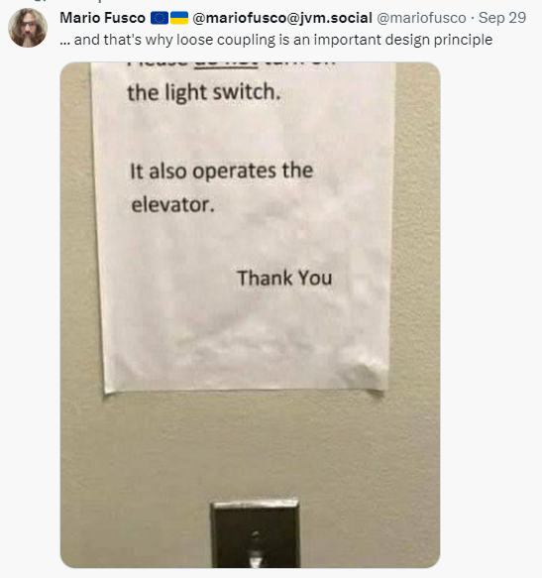
Easier to address circular
dependencies in
security configurations.
Notes:
Elements (version 1)
Elements are used to give more detail to a set of ideas, they should all relate to the same topic.
For example, use this page for a list of deliverables, key roles on a project, phases of a project, or any topic that can be broken down into more specific examples.
Each section should have an icon that relates to the content of that specific element, no icon should be repeated on the same page, and they should all be the same colour.
Keep the text to 1-2 sentences and aim to have about the same amount of content under each element.

Slide 8
@Bean
public SecurityFilterChain securityFilterChain(HttpSecurity http) { return http.build();
}
Notes:
Elements (version 1)
Elements are used to give more detail to a set of ideas, they should all relate to the same topic.
For example, use this page for a list of deliverables, key roles on a project, phases of a project, or any topic that can be broken down into more specific examples.
Each section should have an icon that relates to the content of that specific element, no icon should be repeated on the same page, and they should all be the same colour.
Keep the text to 1-2 sentences and aim to have about the same amount of content under each element.

Slide 9
@Bean
public SecurityFilterChain securityFilterChain(HttpSecurity http)
throws Exception {
http.authorizeRequests().anyRequest().authenticated();
return http.build();
}
Notes:
Elements (version 1)
Elements are used to give more detail to a set of ideas, they should all relate to the same topic.
For example, use this page for a list of deliverables, key roles on a project, phases of a project, or any topic that can be broken down into more specific examples.
Each section should have an icon that relates to the content of that specific element, no icon should be repeated on the same page, and they should all be the same colour.
Keep the text to 1-2 sentences and aim to have about the same amount of content under each element.

Slide 10
http.authorizeRequests().anyRequest().authenticated();
http.authorizeHttpRequests().anyRequest().authenticated();
Notes:
Elements (version 1)
Elements are used to give more detail to a set of ideas, they should all relate to the same topic.
For example, use this page for a list of deliverables, key roles on a project, phases of a project, or any topic that can be broken down into more specific examples.
Each section should have an icon that relates to the content of that specific element, no icon should be repeated on the same page, and they should all be the same colour.
Keep the text to 1-2 sentences and aim to have about the same amount of content under each element.

Slide 11
http.authorizeHttpRequests().anyRequest().authenticated();
http.authorizeHttpRequests(
c -> c. anyRequest().authenticated()
)
Notes:
Elements (version 1)
Elements are used to give more detail to a set of ideas, they should all relate to the same topic.
For example, use this page for a list of deliverables, key roles on a project, phases of a project, or any topic that can be broken down into more specific examples.
Each section should have an icon that relates to the content of that specific element, no icon should be repeated on the same page, and they should all be the same colour.
Keep the text to 1-2 sentences and aim to have about the same amount of content under each element.

Slide 12
antMatchers()
mvcMatchers()
regexMatchers()
requestMatchers()
Notes:
Elements (version 1)
Elements are used to give more detail to a set of ideas, they should all relate to the same topic.
For example, use this page for a list of deliverables, key roles on a project, phases of a project, or any topic that can be broken down into more specific examples.
Each section should have an icon that relates to the content of that specific element, no icon should be repeated on the same page, and they should all be the same colour.
Keep the text to 1-2 sentences and aim to have about the same amount of content under each element.

Slide 13
access(“isAuthenticated()”)
access(new WebExpressionAuthorizationManager(“isAuthenticated()”))
Notes:
Elements (version 1)
Elements are used to give more detail to a set of ideas, they should all relate to the same topic.
For example, use this page for a list of deliverables, key roles on a project, phases of a project, or any topic that can be broken down into more specific examples.
Each section should have an icon that relates to the content of that specific element, no icon should be repeated on the same page, and they should all be the same colour.
Keep the text to 1-2 sentences and aim to have about the same amount of content under each element.

Slide 14
AuthorizationManager
implements
WebExpressionAuthorizationManager
Notes:
Elements (version 1)
Elements are used to give more detail to a set of ideas, they should all relate to the same topic.
For example, use this page for a list of deliverables, key roles on a project, phases of a project, or any topic that can be broken down into more specific examples.
Each section should have an icon that relates to the content of that specific element, no icon should be repeated on the same page, and they should all be the same colour.
Keep the text to 1-2 sentences and aim to have about the same amount of content under each element.

Slide 15
@EnableGlobalMethodSecurity(prePostEnabled=true)
@EnableMethodSecurity
Notes:
Elements (version 1)
Elements are used to give more detail to a set of ideas, they should all relate to the same topic.
For example, use this page for a list of deliverables, key roles on a project, phases of a project, or any topic that can be broken down into more specific examples.
Each section should have an icon that relates to the content of that specific element, no icon should be repeated on the same page, and they should all be the same colour.
Keep the text to 1-2 sentences and aim to have about the same amount of content under each element.

Slide 16

Notes:
Elements (version 1)
Elements are used to give more detail to a set of ideas, they should all relate to the same topic.
For example, use this page for a list of deliverables, key roles on a project, phases of a project, or any topic that can be broken down into more specific examples.
Each section should have an icon that relates to the content of that specific element, no icon should be repeated on the same page, and they should all be the same colour.
Keep the text to 1-2 sentences and aim to have about the same amount of content under each element.

Slide 17

Spring Authorization Server
Notes:
Elements (version 1)
Elements are used to give more detail to a set of ideas, they should all relate to the same topic.
For example, use this page for a list of deliverables, key roles on a project, phases of a project, or any topic that can be broken down into more specific examples.
Each section should have an icon that relates to the content of that specific element, no icon should be repeated on the same page, and they should all be the same colour.
Keep the text to 1-2 sentences and aim to have about the same amount of content under each element.

Slide 18
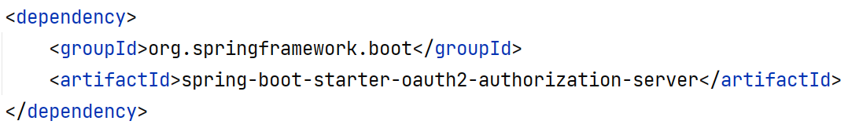
Notes:
Elements (version 1)
Elements are used to give more detail to a set of ideas, they should all relate to the same topic.
For example, use this page for a list of deliverables, key roles on a project, phases of a project, or any topic that can be broken down into more specific examples.
Each section should have an icon that relates to the content of that specific element, no icon should be repeated on the same page, and they should all be the same colour.
Keep the text to 1-2 sentences and aim to have about the same amount of content under each element.

Slide 19
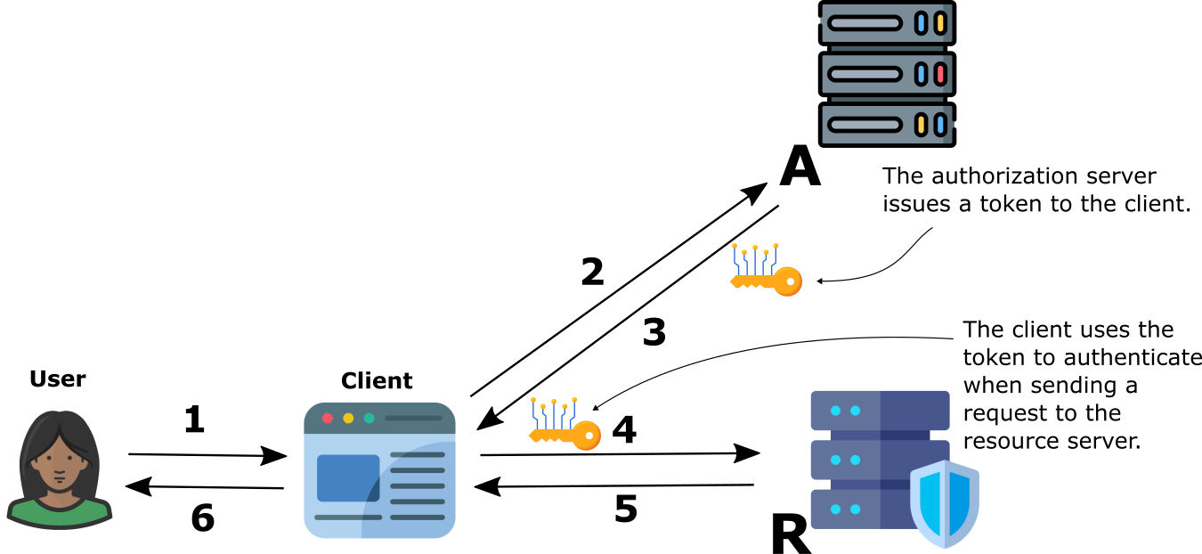
OpenID Connect / OAuth 2
Notes:
Elements (version 1)
Elements are used to give more detail to a set of ideas, they should all relate to the same topic.
For example, use this page for a list of deliverables, key roles on a project, phases of a project, or any topic that can be broken down into more specific examples.
Each section should have an icon that relates to the content of that specific element, no icon should be repeated on the same page, and they should all be the same colour.
Keep the text to 1-2 sentences and aim to have about the same amount of content under each element.

Slide 20
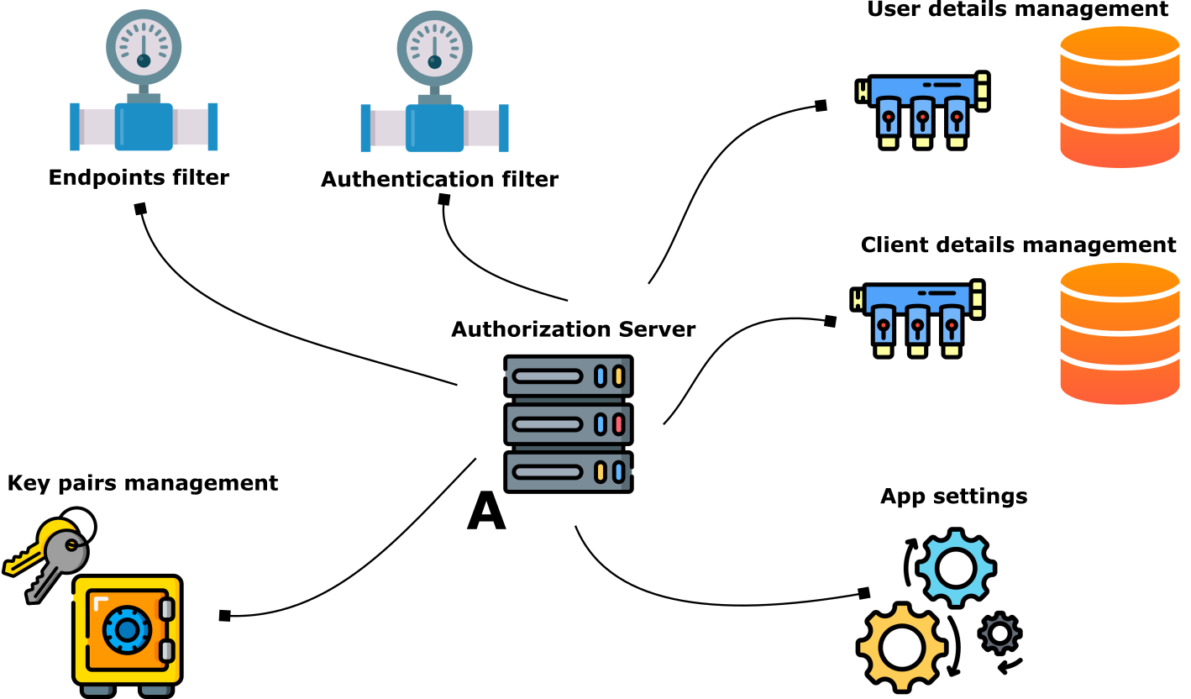
Notes:
Elements (version 1)
Elements are used to give more detail to a set of ideas, they should all relate to the same topic.
For example, use this page for a list of deliverables, key roles on a project, phases of a project, or any topic that can be broken down into more specific examples.
Each section should have an icon that relates to the content of that specific element, no icon should be repeated on the same page, and they should all be the same colour.
Keep the text to 1-2 sentences and aim to have about the same amount of content under each element.

Slide 21
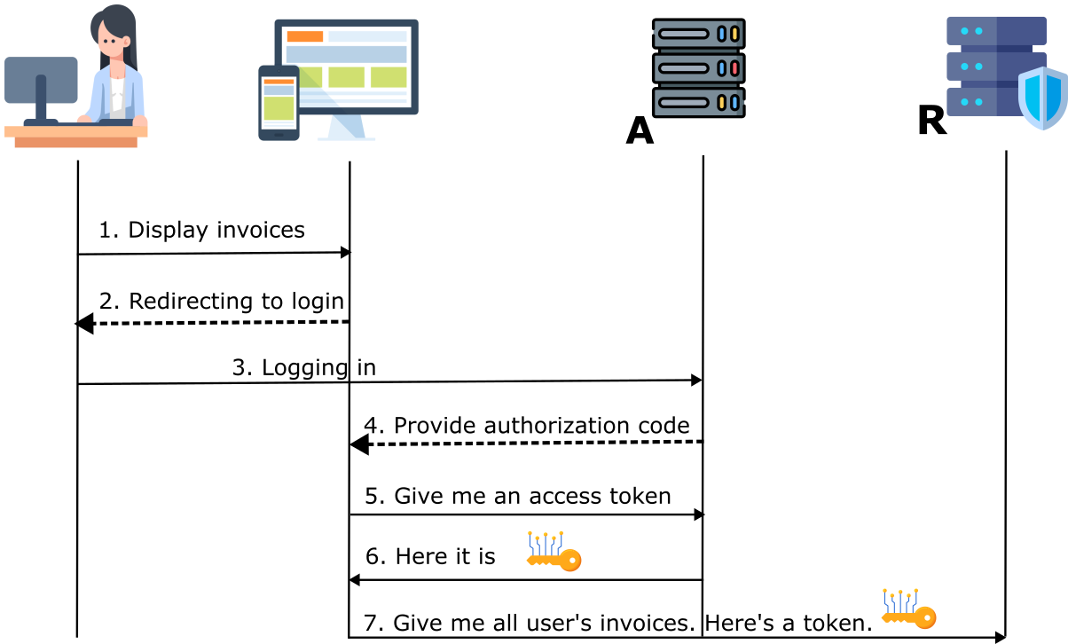
OpenID Connect / OAuth 2
Notes:
Elements (version 1)
Elements are used to give more detail to a set of ideas, they should all relate to the same topic.
For example, use this page for a list of deliverables, key roles on a project, phases of a project, or any topic that can be broken down into more specific examples.
Each section should have an icon that relates to the content of that specific element, no icon should be repeated on the same page, and they should all be the same colour.
Keep the text to 1-2 sentences and aim to have about the same amount of content under each element.

Slide 22
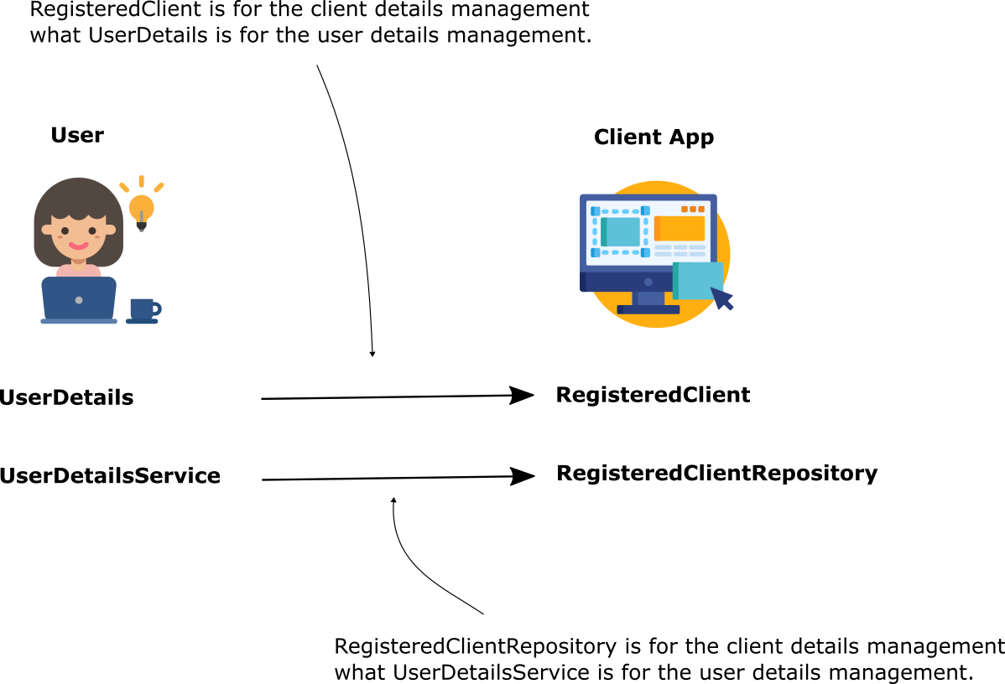
Notes:
Elements (version 1)
Elements are used to give more detail to a set of ideas, they should all relate to the same topic.
For example, use this page for a list of deliverables, key roles on a project, phases of a project, or any topic that can be broken down into more specific examples.
Each section should have an icon that relates to the content of that specific element, no icon should be repeated on the same page, and they should all be the same colour.
Keep the text to 1-2 sentences and aim to have about the same amount of content under each element.

Slide 23
http://localhost:8080/oauth2/authorize?response_type=code&client_id=client&scope=openid&redirect_uri=https://devoxx.be/authorized&code_challenge=QYPAZ5NU8yvtlQ9erXrUYR-T5AGCjCF47vN-KsaI2A8&code_challenge_method=S256
http://localhost:8080/oauth2/authorize?response_type=code&client_id=client&scope=openid&redirect_uri=https://devoxx.be/authorized&code_challenge=QYPAZ5NU8yvtlQ9erXrUYR-T5AGCjCF47vN-KsaI2A8&code_challenge_method=S256
http://localhost:8080/.well-known/openid-configuration
Notes:
Elements (version 1)
Elements are used to give more detail to a set of ideas, they should all relate to the same topic.
For example, use this page for a list of deliverables, key roles on a project, phases of a project, or any topic that can be broken down into more specific examples.
Each section should have an icon that relates to the content of that specific element, no icon should be repeated on the same page, and they should all be the same colour.
Keep the text to 1-2 sentences and aim to have about the same amount of content under each element.

Slide 24
http://localhost:8080/oauth2/authorize?
response_type=code&
client_id=client&
scope=openid&
redirect_uri=https://devoxx.be/authorized&
code_challenge=QYPAZ5NU8yvtlQ9erXrUYR-T5…
code_challenge_method=S256
http://localhost:8080/oauth2/authorize?response_type=code&client_id=client&scope=openid&redirect_uri=https://devoxx.be/authorized&code_challenge=QYPAZ5NU8yvtlQ9erXrUYR-T5AGCjCF47vN-KsaI2A8&code_challenge_method=S256
http://localhost:8080/oauth2/authorize?response_type=code&client_id=client&scope=openid&redirect_uri=https://devoxx.be/authorized&code_challenge=QYPAZ5NU8yvtlQ9erXrUYR-T5AGCjCF47vN-KsaI2A8&code_challenge_method=S256
Notes:
Elements (version 1)
Elements are used to give more detail to a set of ideas, they should all relate to the same topic.
For example, use this page for a list of deliverables, key roles on a project, phases of a project, or any topic that can be broken down into more specific examples.
Each section should have an icon that relates to the content of that specific element, no icon should be repeated on the same page, and they should all be the same colour.
Keep the text to 1-2 sentences and aim to have about the same amount of content under each element.

Slide 25
http://localhost:8080/oauth2/token?
client_id=client&
redirect_uri=https://devoxx.be/authorized&
grant_type=authorization_code&
code=IhKRpq7GJ7P5VQI_...&
code_verifier=qPsH306-ZDDaOE8DFzVn05TkN3…
Notes:
Elements (version 1)
Elements are used to give more detail to a set of ideas, they should all relate to the same topic.
For example, use this page for a list of deliverables, key roles on a project, phases of a project, or any topic that can be broken down into more specific examples.
Each section should have an icon that relates to the content of that specific element, no icon should be repeated on the same page, and they should all be the same colour.
Keep the text to 1-2 sentences and aim to have about the same amount of content under each element.

Slide 26
What to next at #Devoxx?
Notes:
Elements (version 1)
Elements are used to give more detail to a set of ideas, they should all relate to the same topic.
For example, use this page for a list of deliverables, key roles on a project, phases of a project, or any topic that can be broken down into more specific examples.
Each section should have an icon that relates to the content of that specific element, no icon should be repeated on the same page, and they should all be the same colour.
Keep the text to 1-2 sentences and aim to have about the same amount of content under each element.

Slide 27
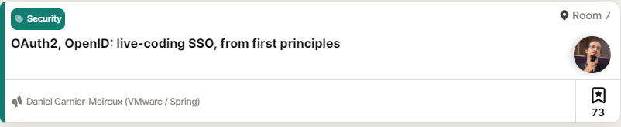
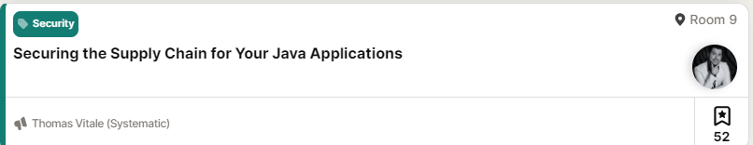
Notes:
Elements (version 1)
Elements are used to give more detail to a set of ideas, they should all relate to the same topic.
For example, use this page for a list of deliverables, key roles on a project, phases of a project, or any topic that can be broken down into more specific examples.
Each section should have an icon that relates to the content of that specific element, no icon should be repeated on the same page, and they should all be the same colour.
Keep the text to 1-2 sentences and aim to have about the same amount of content under each element.

Slide 28
laurspilca.com/blog
youtube.com/c/laurentiuspilca
@laurspilca
Laurentiu Spilca
Notes:
Elements (version 1)
Elements are used to give more detail to a set of ideas, they should all relate to the same topic.
For example, use this page for a list of deliverables, key roles on a project, phases of a project, or any topic that can be broken down into more specific examples.
Each section should have an icon that relates to the content of that specific element, no icon should be repeated on the same page, and they should all be the same colour.
Keep the text to 1-2 sentences and aim to have about the same amount of content under each element.

Slide 29
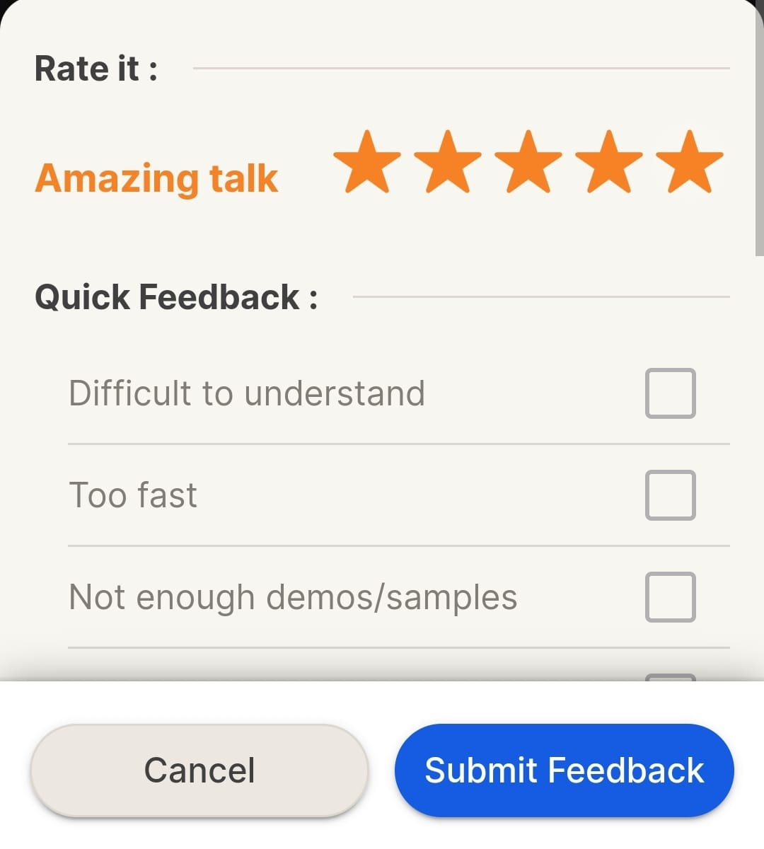
Notes:
Elements (version 1)
Elements are used to give more detail to a set of ideas, they should all relate to the same topic.
For example, use this page for a list of deliverables, key roles on a project, phases of a project, or any topic that can be broken down into more specific examples.
Each section should have an icon that relates to the content of that specific element, no icon should be repeated on the same page, and they should all be the same colour.
Keep the text to 1-2 sentences and aim to have about the same amount of content under each element.

